Slide 1


Prediction of Vessel RAOs:
Applications of Deep Learning to Assist in Design
James Frizzell │ Dr. Mirjam Furth
Texas A&M University
02/22/2022
Notes:
Undergraduate OE Student at TAMU

Slide 2
Objective Overview
Develop a fast, accurate algorithm to estimate Response Amplitude Operators (RAOs)
Show all RAO values in a frequency spectrum
Account for wave direction in response determination
Avoid the need for detailed Computer Aided Design (CAD) Modelling
The 27th Offshore Symposium
Notes:
Develop software to quickly and accurately predict vessel RAOs
Software capabilities: Show entire frequency and accept multiple wave directions
Avoid CAD to check feasibility of design in early stages
Accept a few vessel particulars
Compare predictions with known sea states

Slide 3
Proof-of-Concept Process
Simplify vessel dataset to series of box barges
Analyze the RAOs of each vessel in ANSYS AQWA
Develop and train a Deep Neural Network (DNN) on the data
Create an interface to accept user inputs and provide predicted RAOs
The 27th Offshore Symposium

Slide 4
Data Collection
Parametric study of 142 box barges
Frequency-dependent response was evaluated in 6 degrees of freedom
Curve of general forms were fit to the data for each degree of freedom
Parameters A, B, and C were used as training features for the DNN
Length | 2 - 25 meters
Beam | 1 - 16 meters
Draft | 0.15 - 1.23 meters
f(x) = Ae^{-Bx} + Cxe^{-Bx} | Surge, Sway
f(x) = A arctan(Bx+C) + 0.5 | Heave
f(x) = Ae^{-(x-B)^2/C} | Roll, Pitch, Yaw
The 27th Offshore Symposium

Slide 5
Data Collection - Why choose those equations?
Needed to simplify the raw data into curves with minimal number of coefficient parameters.
Selected equations that naturally looked similar to the RAO curves
Because box barges were used, equations could be reused for multiple degrees of freedom
Other curves considered:
3rd-, 6th- and 9th-order polynomials
Issues: too many output parameters, RAO curves poorly fit to equations of these forms
 | X (Surge) | Y (Sway) | Z (Heave) | RX (Roll) | RY (Pitch) | RZ (Yaw)
Average R-Squared | 0.85 | 0.89 | 0.94 | 0.92 | 0.93 | 0.96

Slide 6
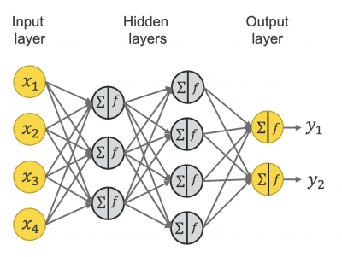
Basic Neural Network Architecture
Multiple inputs (x₁… x_{n}) are passed into the model
Each input is passed through each node on a hidden layer
The inputs are summed together with varying weights applied to each input
The resulting summation from each node is passed as an input to each of the nodes in the next hidden layer
Credit: knime.com
∑ f = ω₁x₁+ ω₂x₂+ … + ω_{n}x_{n}
The 27th Offshore Symposium
Notes:
(not a machine learning expert)

Slide 7
Neural Network Architecture
Use Tensorflow with Keras API
4 vessel characteristics chosen as inputs
3 parameters (A, B, C) for all degrees of freedom set as outputs
Total of 18 outputs
Length | 2 → 25 meters
Beam | 1 → 16 meters
Draft | 0.15 → 1.23 meters
Wave Heading | -180 → 180° (45° increments)
The 27th Offshore Symposium

Slide 8
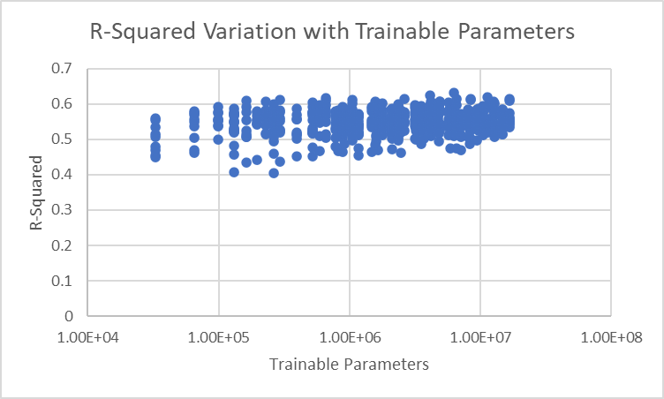
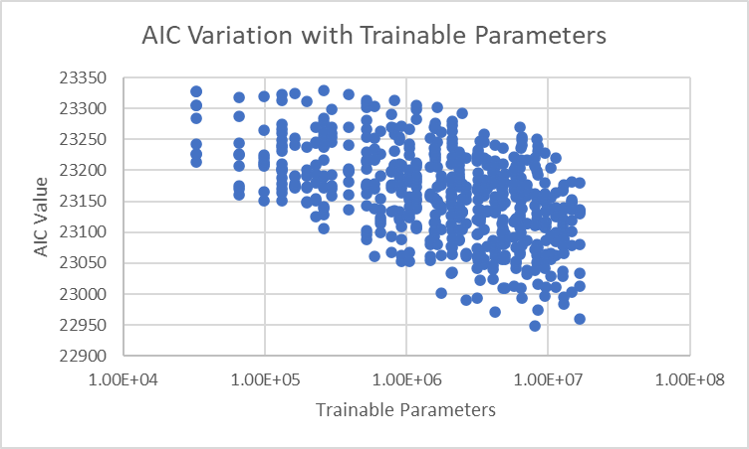
Neural Network Architecture - Model Selection
Parametric evaluation of model architecture
Evaluate Akaike Information Criteria (AIC) and R-Squared for each model
Highest Performing Model:
3 hidden layers
16.7 million trainable parameters
Input Layer | Hidden Layer 1 | Hidden Layer 2 | Hidden Layer 3 | Output Layer
4 | 128 | 256 | 256 | 18
Selected Architecture Neuron Counts, detailed
The 27th Offshore Symposium
Notes:
# of trainable parameters define by the product sum of neurons in hidden layers + output layer

Slide 9
Neural Network Architecture - Hyperparameters
Optimizer | Keras Adam
Learning Rate | 0.001
Dropout | 20%, Between each hidden layer
Normalization | Batch Normalization between input and first hidden layer
Activation | ReLu
Loss Type | Mean Absolute Error
Validation Split | 0.2
Training Duration | 250 Epochs

Slide 10
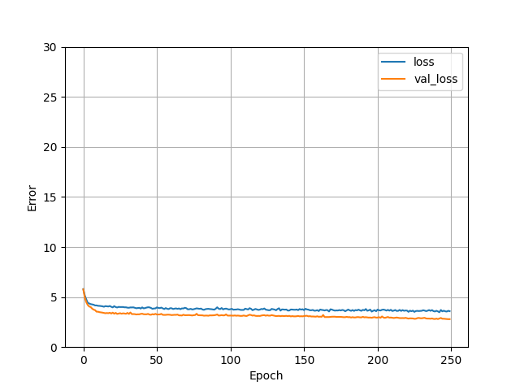
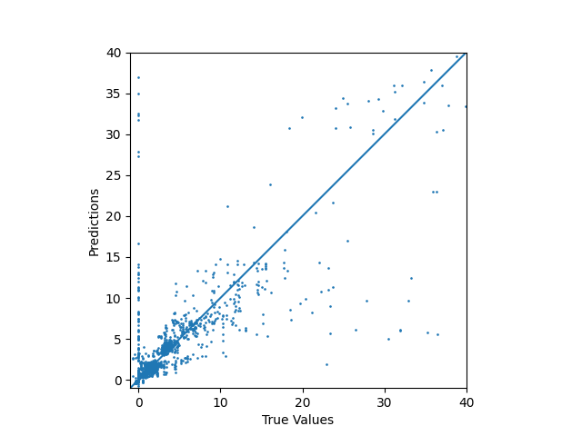
Training Results
Several parameters that should be 0 are not
Slope Approaches 0
R² = 0.668
The 27th Offshore Symposium
Notes:
Slope = 0, not under fit to data
Slope not spiky, not overfit
Model tends to fail to assign certain parameters to be 0, this issue persisted through our best efforts to reduce the impact

Slide 11
Neural Network Architecture Visualization
Hidden Layer 1
Hidden Layer 2
Hidden Layer 3
Outputs
Inputs
A1
B1
Length
Node 1
Node 1
Node 1
C1
A2
A, B, C parameters are passed into their respective equations for all n degrees of freedom, 1 - 6
Beam
Node 2
Node 2
Node 2
B2
C2
Draft
A6
Wave Heading
Node 128
Node 256
Node 256
B6
C6
The 27th Offshore Symposium

Slide 12
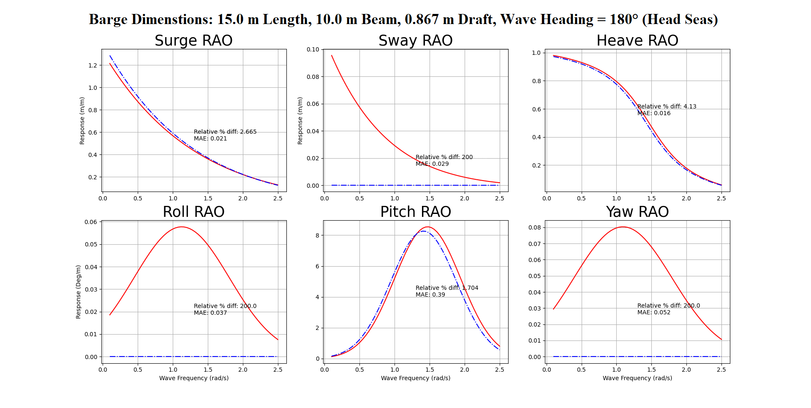

Sample Results - Accuracy Metrics
Barge Dimensions: 15.0 m Length, 10 m Beam, 0.867 m Draft
Wave Heading = 180° (Head seas)
Relative Percent Difference (RPD) used to avoid division by zero issues
Some RAOs have high RPD, but low MAE error.
The MAE error is more important in these cases
Identified with a dot
The 27th Offshore Symposium
Notes:
Point out how surge, heave, pitch ‘look’ right
Point out the y-axis scale for other dof

Slide 13
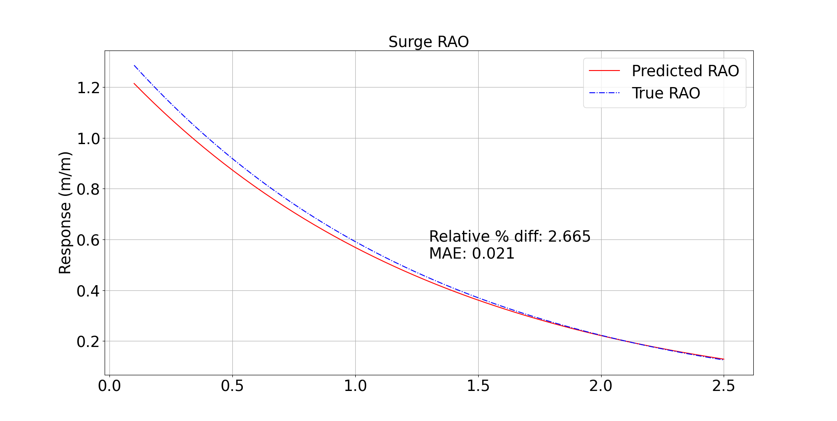
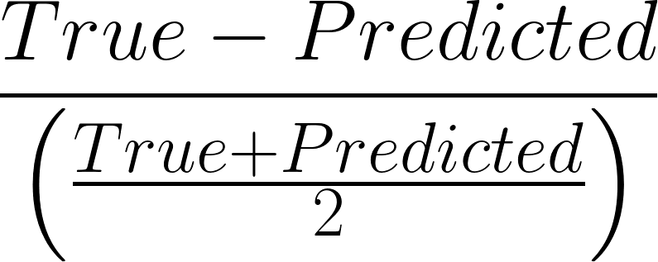
Sample Results - Relative Percent Difference
RPD is defined as:
Barge Dimensions: 15.0 m Length, 10 m Beam, 0.867 m Draft
Wave Heading = 180° (Head seas)
When the true value is not 0 (pictured), the RPD is an accurate measure of the model quality
RPD falls in range 0-200, lower is better
Wave Frequency (rad/s)
The 27th Offshore Symposium
Notes:
In this case, both RPD and MAE show that the model is well-fit to the data

Slide 14
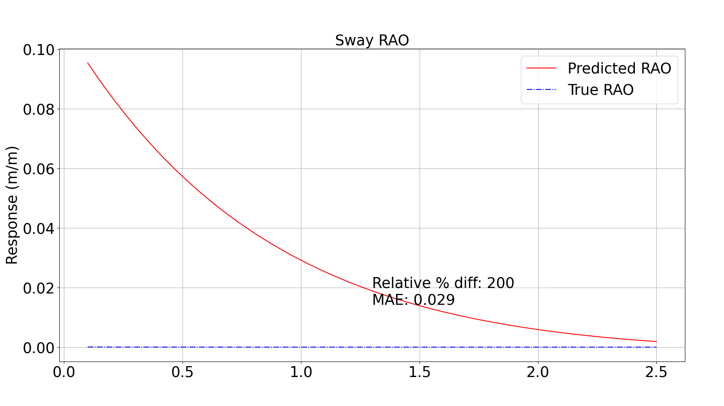
Sample Results - MAE
Barge Dimensions: 15.0 m Length, 10 m Beam, 0.867 m Draft
Wave Heading = 180° (Head seas)
When the true value is 0 (pictured), RPD grows very large
Here, the MAE more accurately describes the model quality
Wave Frequency (rad/s)
The 27th Offshore Symposium
Notes:
When true = 0, RPD = 200.
Looking at MAE, this is still very accurate, so we ignore the high RPD

Slide 15
Error Analysis
Notes:
Previous results were hand-picked to showcase why the RPD is sometimes a poor metric
To quantify the overall accuracy of the model, 120 vessel were chosen at random for comparison.

Slide 16
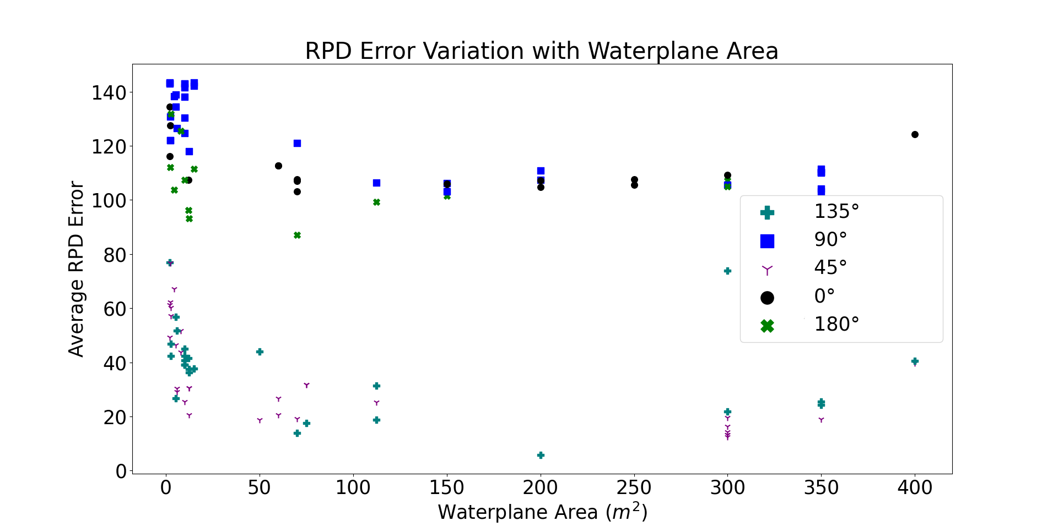
Error Analysis - Effect of Barge Size
Large Variation in RPD for small barges
More consistent RPD for large barges
The 27th Offshore Symposium
Notes:
Model is unaffected by barge size.
When simulating a smaller vessel, you are less sure of how inaccurate the model is
When simulating a larger vessel, you can be sure that the error is within a certain range.

Slide 17
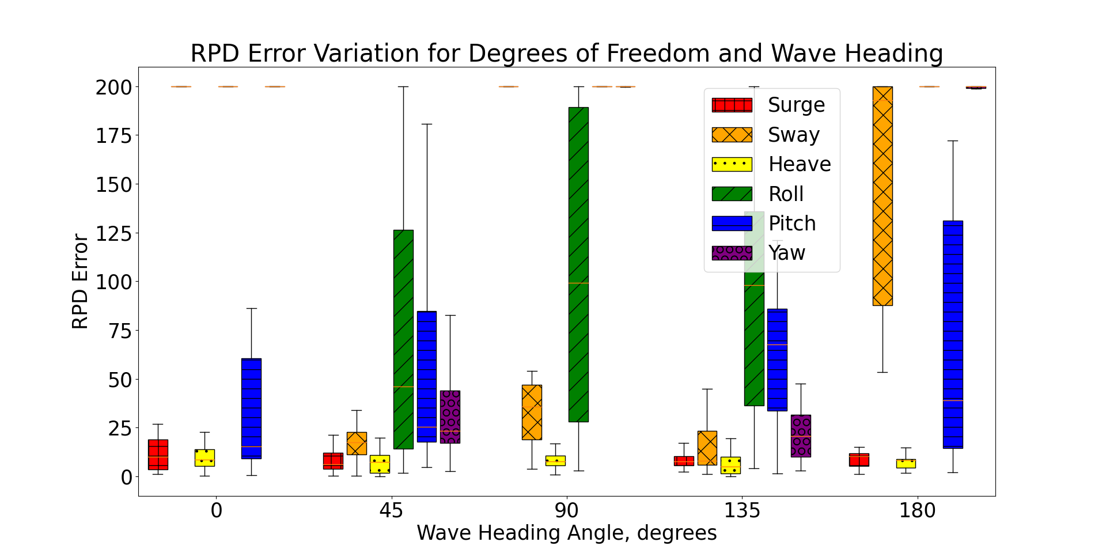
Error Analysis - Effect of Wave Direction
The 27th Offshore Symposium
Notes:
Note the 180 degree Sway, Roll, Yaw

Slide 18
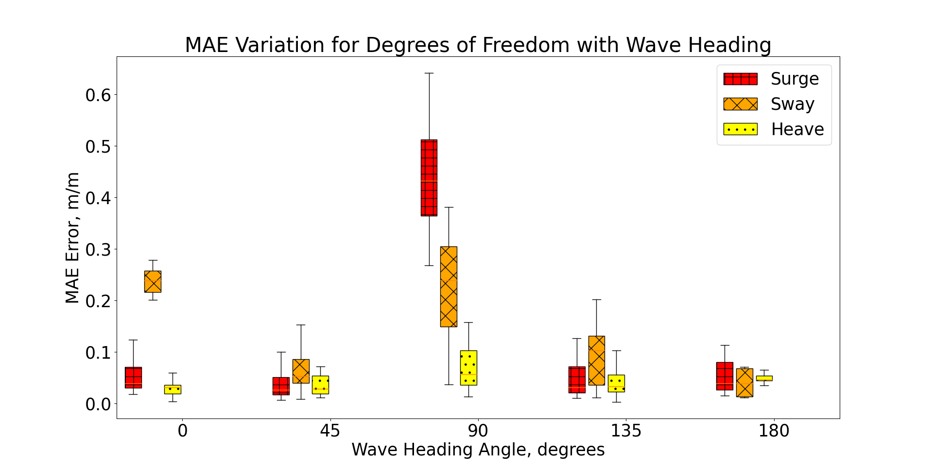
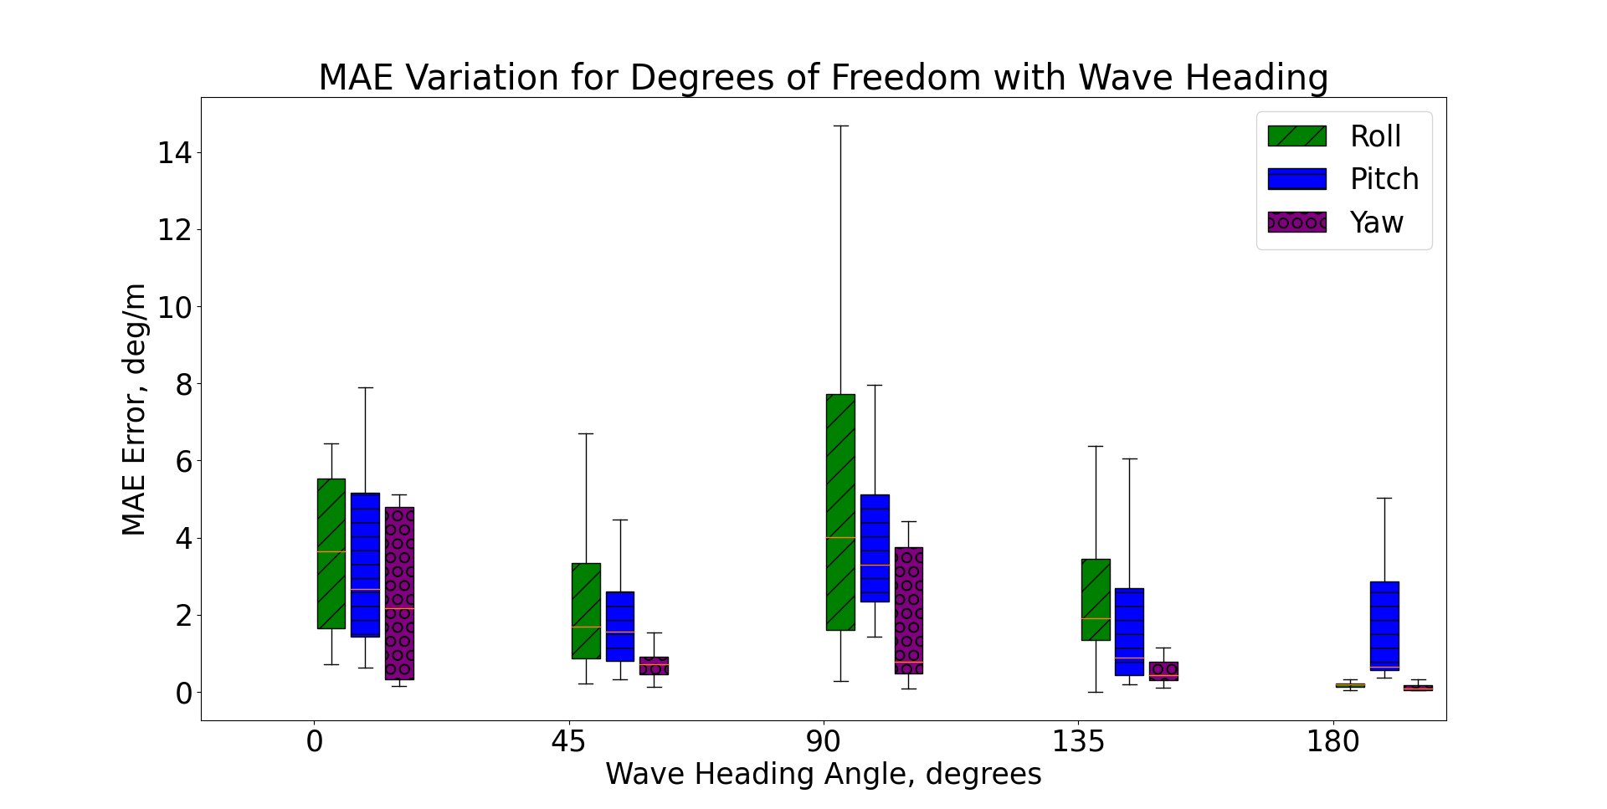
Error Analysis - Effect of Wave Direction
The 27th Offshore Symposium
Notes:
Point out the 180 degree Sway roll yaw
Sway < 10 cm per meter
Roll and yaw nearly 0 degree per meter

Slide 19
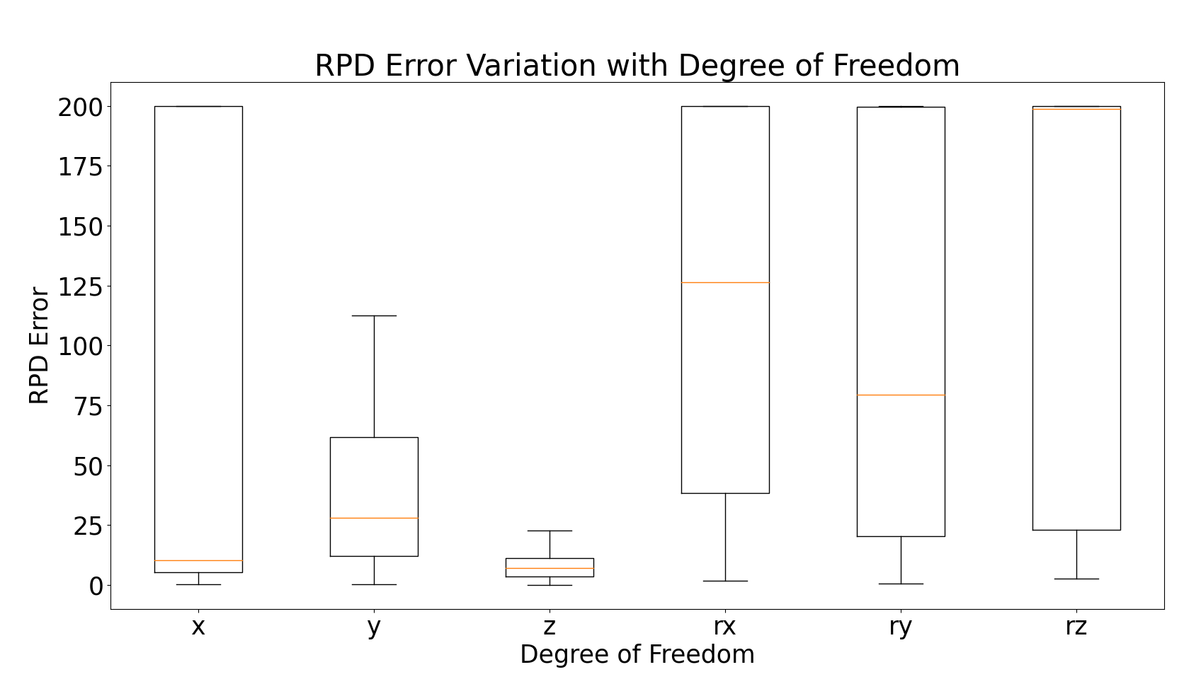
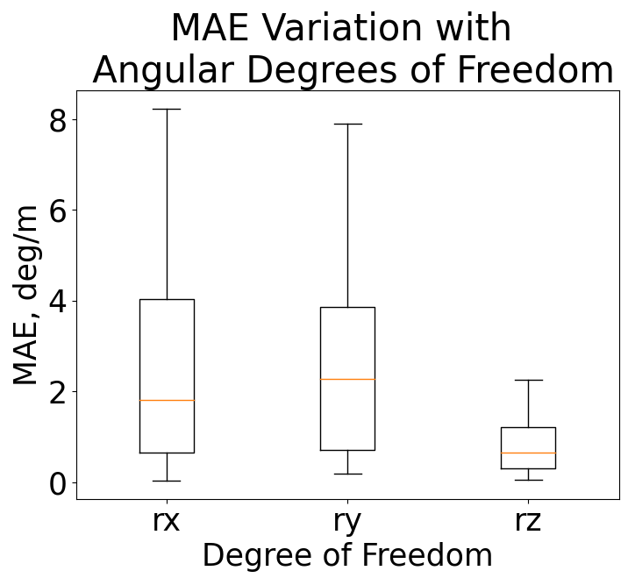
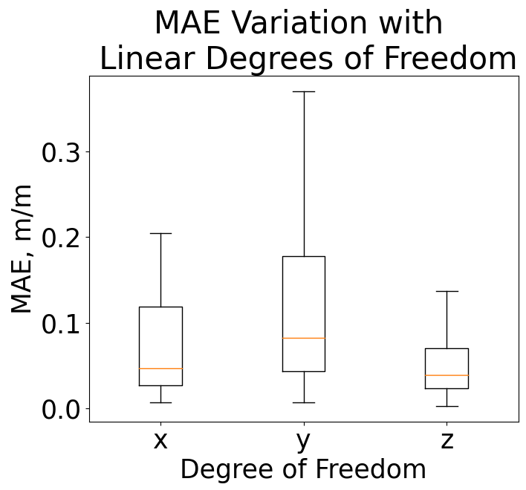
Error Analysis - Effect of Degree of Freedom
The 27th Offshore Symposium
Notes:
Angular degrees of freedom had higher RPD
Overall, linear MAE < 0.25 m/m
Angular MAE < 4 deg/m

Slide 20
Future Work
Expand dataset to include more hullforms
Wigley Hull will be considered next
Continue refining the Neural Network
Consider other curve fitting equations
Split into 2 models:
Combine Surge, Sway, Heave (linear displacement)
Combine Roll, Pitch, Yaw (angular displacement)
Perform wave tank experiment to verify model accuracy
The 27th Offshore Symposium

Slide 21
Thank You
Training Data, Tensorflow Model and Functional Software are available on GitHub:
https://github.com/jafrizzell/RAO-Research
The 27th Offshore Symposium

Slide 22
Appendices

Slide 23
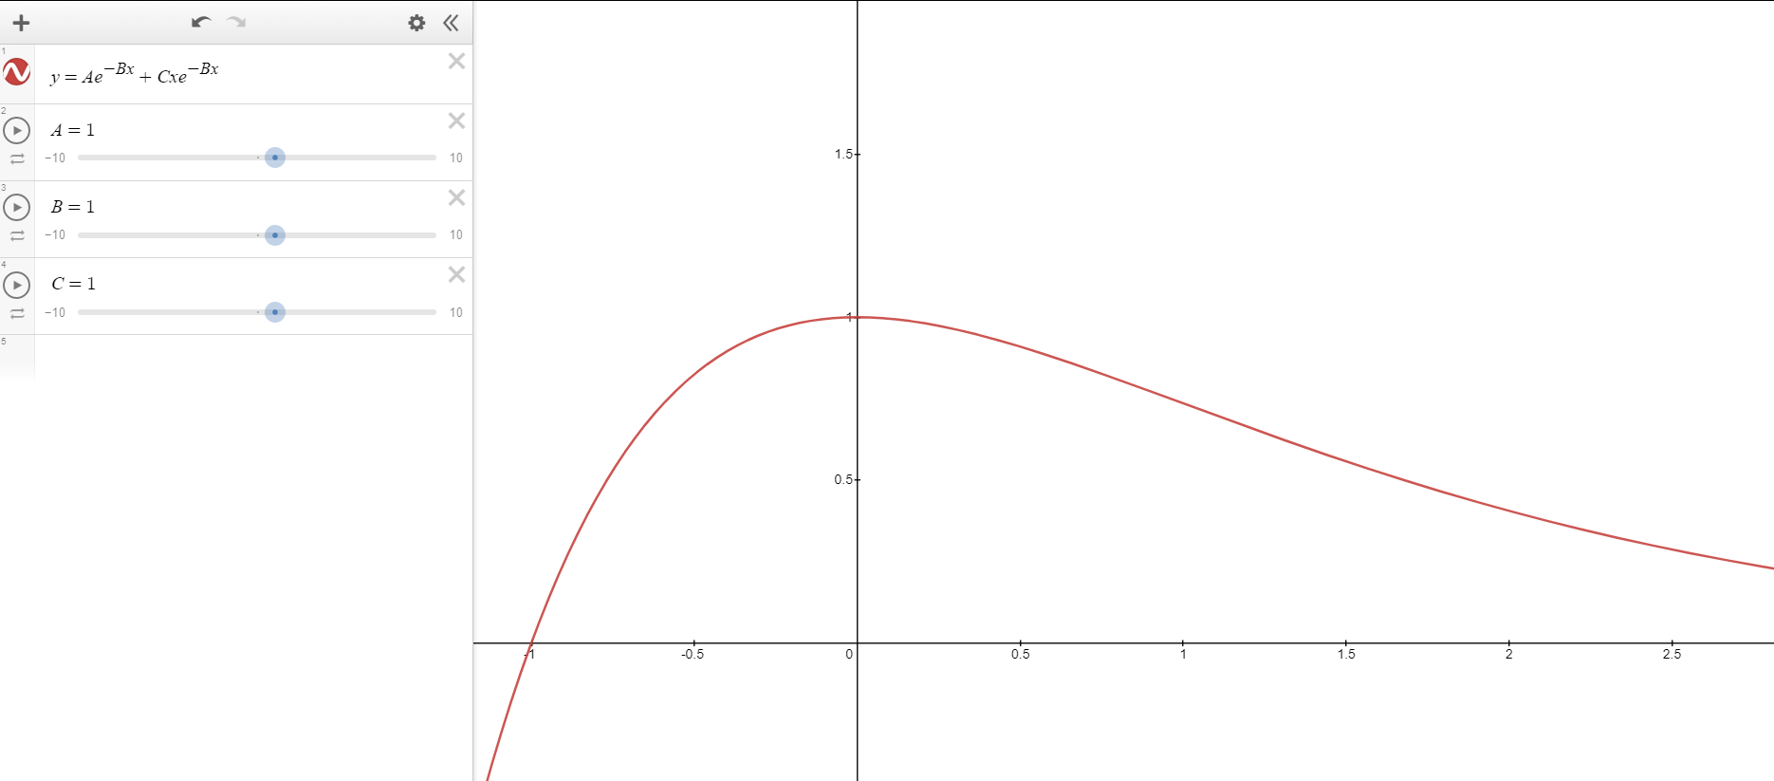
Damped Spring Equation

Slide 24
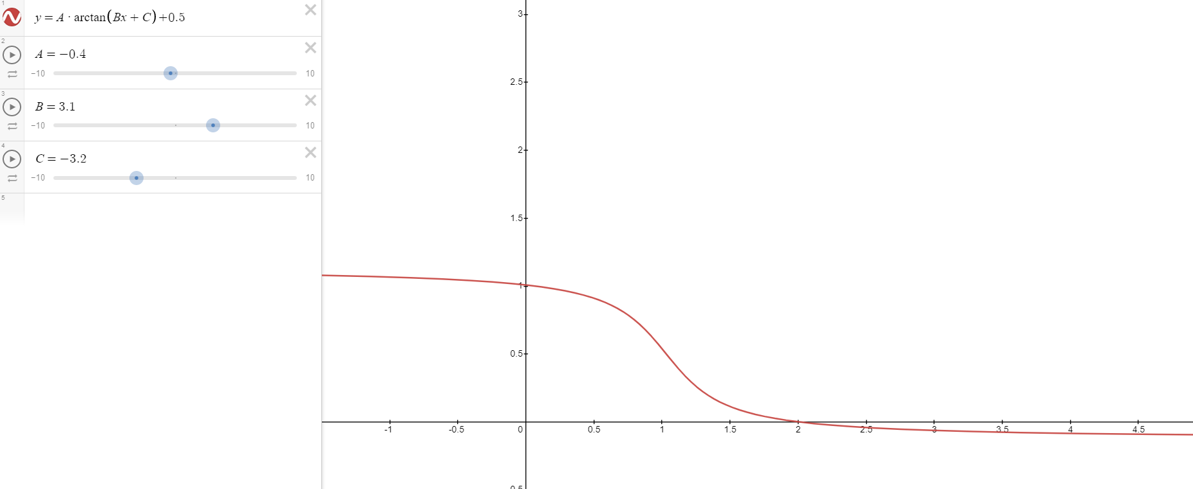
Arctangent Equation

Slide 25
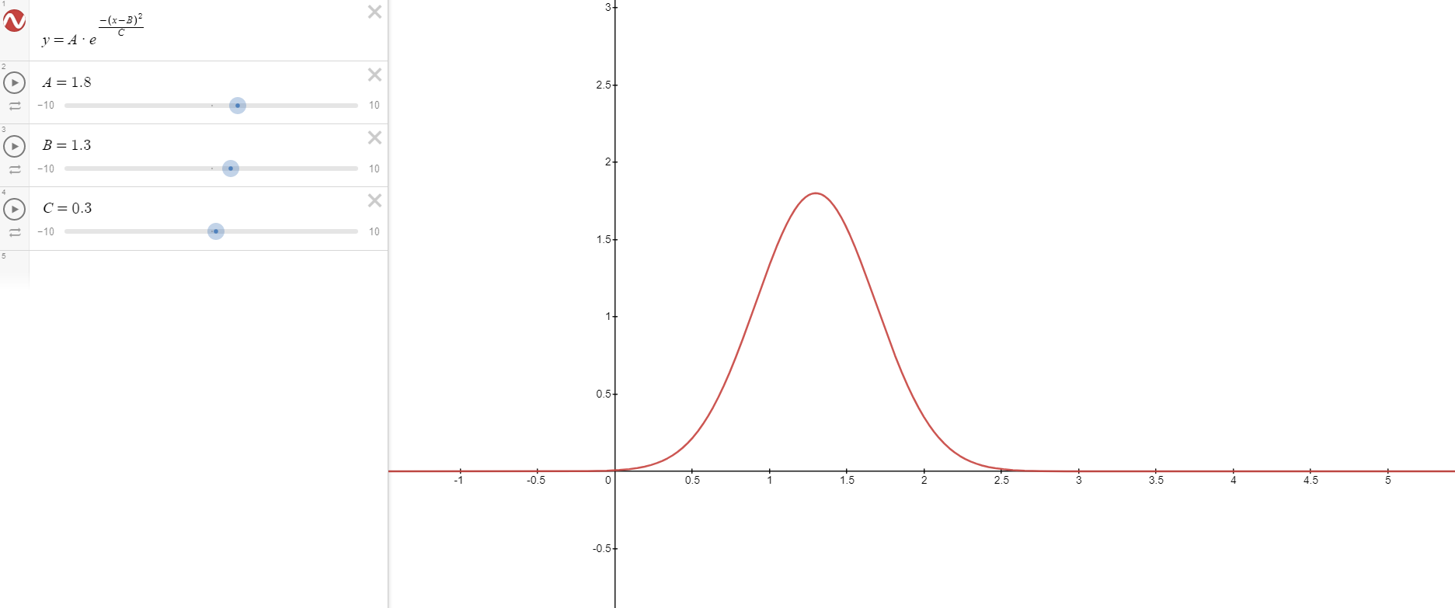
Gaussian Equation

Slide 26
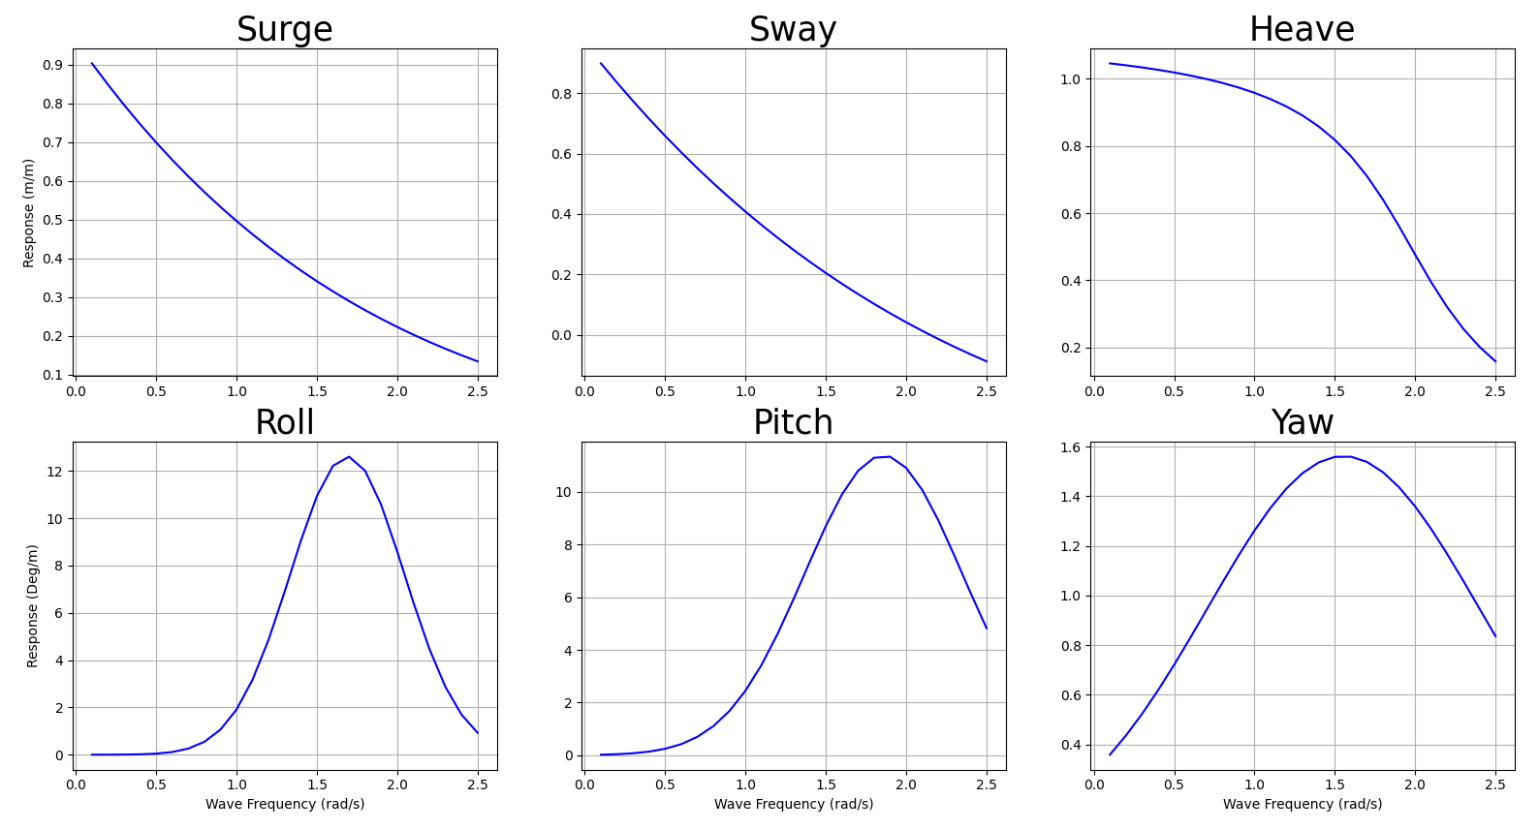
Software Outputs

